Slide 1

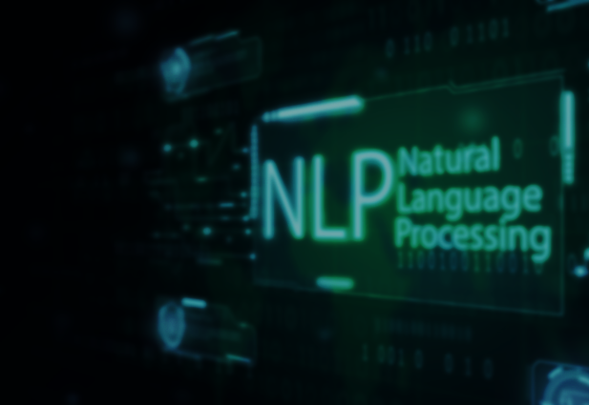

Wordnet with NLP
2
+
2
+
SEM V MINI PROJECT
AYTIJHA CHAKRABORTY
BTECH(CSE-AI/ML)
SEC K, ROLL 15
UNIVERSITY ROLL 1914009

Slide 2


OUTLINE OF THE PRESENTATION
2
+
NLP ABSTRACT
WORDNET AND CORPUS READERS
PROJECT ABSTRACT
PROJECT PIPELINE
GLOSSARY
2

Slide 3
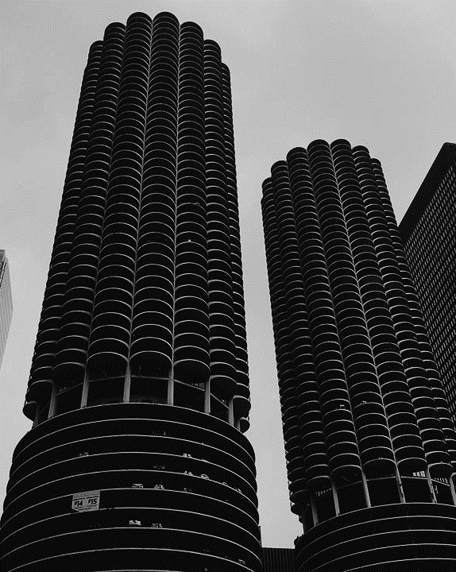

Natural Language processing
2
+
AND IT’S APPLICATION IN ML
Natural Language Processing, or NLP for short, is broadly defined as the automatic manipulation of natural language, like speech and text, by software.
Applications of NLP can be diverse, such as:
Tokenization and Text Classification
Speech Recognition
Document Summarization
Image Captioning
And many more…

Slide 4


WORDNET
2
+
AND OTHER CORPUS READERS
WordNet is one of the available Corpus Readers in nltk.corpus. It is a large lexical database of English, compiled by Princeton Uni. It contains of Synsets - sets of cognitive synonyms (synsets), each expressing a distinct concept. These Synsets are then interlinked by means of conceptual, semantic and lexical relations.
WordNet labels the semantic relations among words, and the majority of its relations connect words from the same part of speech (POS). Thus, WordNet really consists of four sub-nets, one each for nouns, verbs, adjectives and adverbs, with few cross-POS pointers.
A Corpus Reader, in general, provides a variety of methods to read data from the corpus, depending on the format of the corpus. NLTK provides corpus readers like WordNet, FrameNet, Plaintext Corpora, and PropBank.

Slide 5
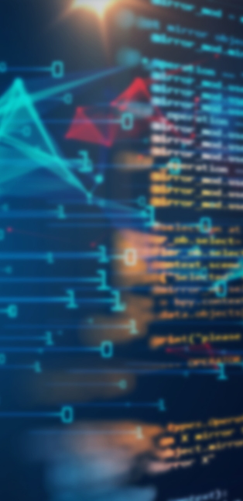

CARAMEL POPCORN
MOVIE ANALYSER
Project Abstract
Pipeline
This project (named Caramel Popcorn) is a small-scale implementation of a Movie Analysis System. This means that upon being provided the details of a movie, the probability of it making a huge success can be accurately predicted.
This project attempts to predict how successful a movie will be in the Box Office, even before it is actually released.
The pipeline of the project includes three components as of now:
Data Scraping [Modules Used: BeautifulSoup]
Feature Exploration and Engineering [Languages Used: Python]
NLP Classification [Modules Used: NLTK, MultinomialNB, SVC] [Corpus Used: WordNet]

Slide 6
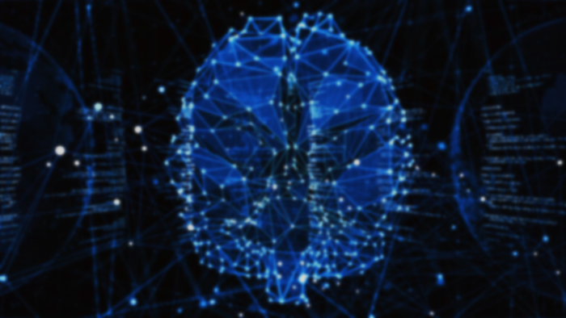
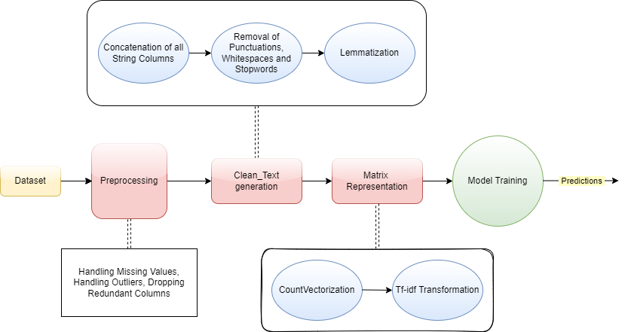
Flow of pipeline
2
+

Slide 7

gLOSSARY
Idf – It is the inverse of the document frequency which measures the informativeness of a term. It is very low for the most occurring words such as stop words.
Tf –Term Frequency is a measure of the frequency of a word in a document, accounting for the length of the document and the generality of the word.
Support Vectors – They are data points that are closer to the hyperplane and influence the position and orientation of the hyperplane. Using these support vectors, we maximize the margin of the classifier.
Stopwords – Words that have no particular meaning/contribution to the text, and are hence omitted.
Lemmatization – The process of reducing words to their atomic forms, eg. – children to child, changing to change.
Count Vectorization – The process of counting the number of occurrences of each word that appears in a document, and then turning it into an encoded vector of those counts.
Df – Document Frequency measures the importance of documents in a whole set of the corpus.

Slide 8
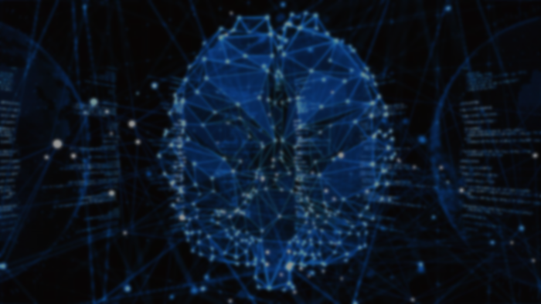
THANK YOU
2
+
AYTIJHA CHAKRABORTY
BTECH(CSE-AI/ML)
SEC K, ROLL 15
UNIVERSITY ROLL 1914009

